Slide 1
Bank Loan of Customers
Mentor : Shubham Sir
Group no : 1 (P-162)
Group Members :
Ms. Prerana Uday Rane | Mr. Jason Allen Noronha
Ms. Disha Sharma | Mr. Vallabh Rajendra Pathak
Mr. P Naveen Lakshman | Mr. Akash Raju Kadam
Mr. Pratik Nitin Sonawale

Slide 2
Table of contents
01
02
03
04
05
Project Objective
Dataset Introduction
KPI’s Contents
Explanation of KPI’s
Conclusion

Slide 3

Project Objective
This is Bank loan of Customers project where we were provided with 2 datasets with .csv extension files having 39k rows each and the objective was to analyze the growth that bank got within given years in loans.
We used MS-Excel, MySQL for analyzing, cleaning and removing duplicates from dataset and prepared dashboard using Tableau and Power BI tools where we did calculations, merging and prepared interactive dashboards.

Slide 4


Dataset Introduction
Domain : Finance
Project : Bank loan of customers
Datasets : Finance_1.xlsx & Finance_2.xlsx
Dataset Type : Excel Data Dataset
Size: Each Excel file has 39k+ records

Slide 5
03
KPI’s Contents
KPI-1 : Year wise loan amount Stats
KPI-2 : Grade and sub grade wise revol_bal
KPI-3 : Total Payment for Verified Status Vs Total Payment for Non Verified Status
KPI-4 : State wise and last_credit_pull_d wise loan status
KPI-5 : Home ownership Vs last payment date stats

Slide 6
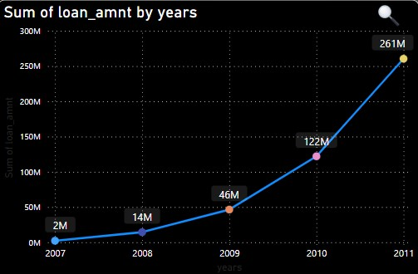
KPI 1
Year wise loan amount Stats
The Loan amount is directly proportional with the increasing years.
It is continuously increasing by each year as you see it‘s varies from 2.22M to 260.51M between the years 2007 to 2011.
From the year 2009, The changes in loan amount is suddenly increased with a higher rate that is around 5 times higher rate for next 2 years as compared to previous 2 years

Slide 7

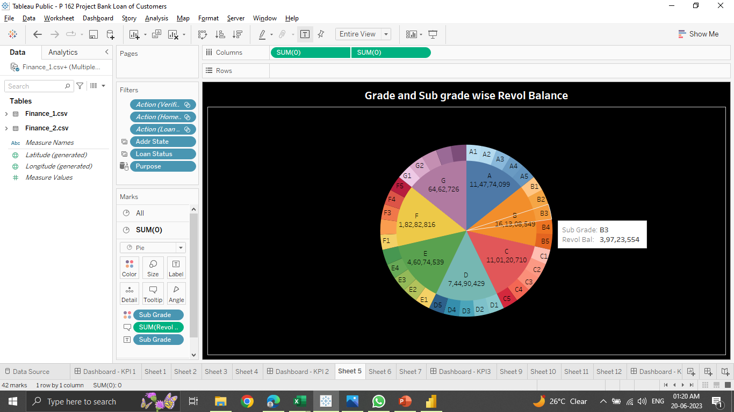
KPI 2: Grade and sub grade wise revol_bal
There are 7 main grades and it‘s further consists of 5 sub-grades, It is shown by different colors in the representation from grade A to G.
The average revolving balance is higher in the ‘grade B’ its around 29M and the maximum reaches in the ‘sub-grade B3’ that is 39M, Same like the average lower revolving balance is in ‘grade G’ its around 1200K and the minimum reaches in the ‘sub-grade G5’ that is 701k.
In this Grade and subgrade wise revol balance we can notice Grade-B have more revol balance then any other grade & Grade-G have very low revol balance.
As we can see that Grade B customers has higher annual income for 10+ yrs of employment period, so higher the annual income lower the Debt to income ratio and hence, more number of customers took loan in Grade B .
Similarly, it goes for other grades also B>A>C>D>E>F>G order for revol bal as per annual income

Slide 8
KPI 3
Total Payment for Verified Status Vs Total Payment for Non Verified Status
The total payment for verified account is higher as compared to non-verified.
There are 58.88% verified accounts and remaining 41.12% are non-verified.
This is the first stage of the verification process. The bank needs a loan application to initiate the document collection and verification process

Slide 9
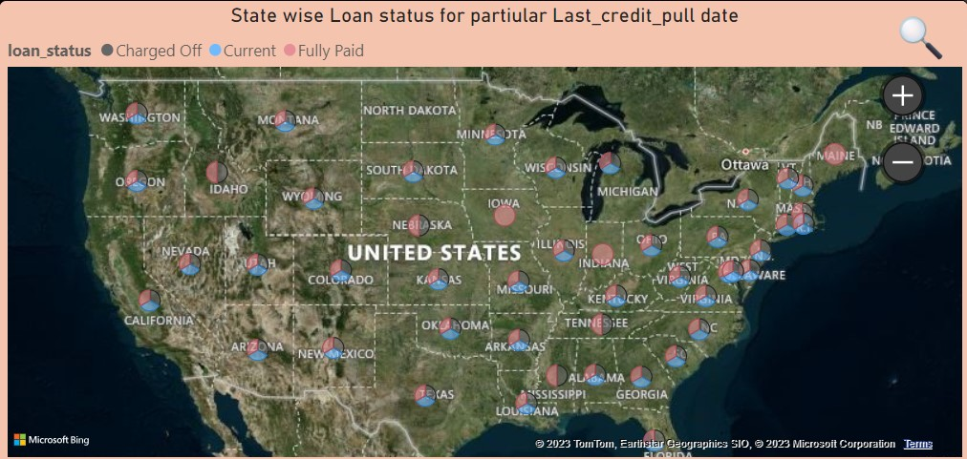
KPI 4
State wise and last_credit_pull_d wise loan status insights
In the dataset we have 50 state, along with the 3 type of loan status. That is changed off, current and fully paid.
As you see from the representation, State ‘CALIFORNIA’ has the highest number of accounts in each type of lone status specially fully paid accounts. And state ‘MAINE’ has the lowest number of accounts in each type of loan status.
The right graph shows the count of Loan Status in each state of USA on particular last credit pull date.

Slide 10
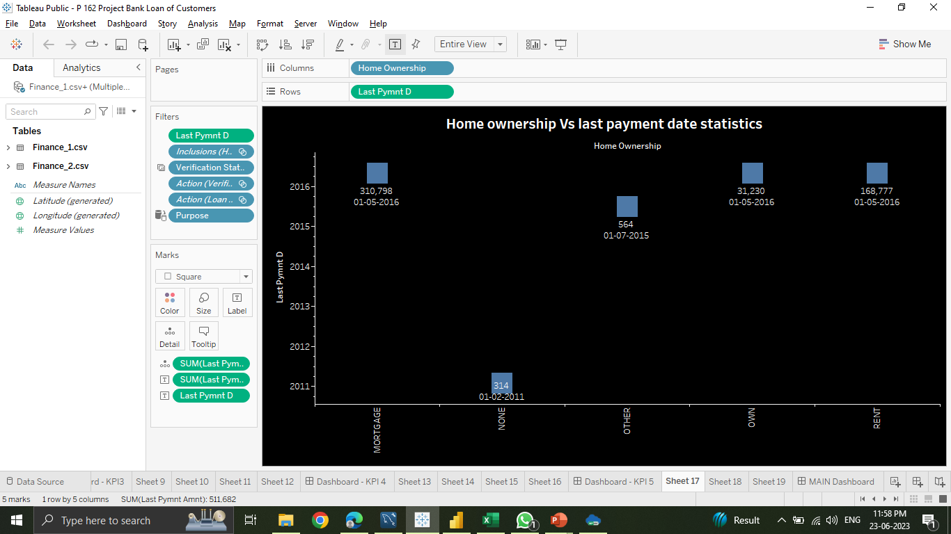
KPI 5 : Home ownership Vs last payment date stats
Home ownership consists of the 3 types that is mortgage, own and rent indicted by different colour blue, brown and orange respectively.
In the bar plot of representation, The type of amount of Home ownership varies from 2008 to 2016. And the maximum amount reaches in year 2012, That is around 31M. And the minimum amount is in 2008.
The right graph shows the Home ownership and the amount paid for each on last payment date.
Here, we can see that maximum latest amount paid by customers with MORTGAGE home ownership is Rs.310,798.
It concludes that many of the customers are about to repay their loan amount for their particular home ownership.

Slide 11
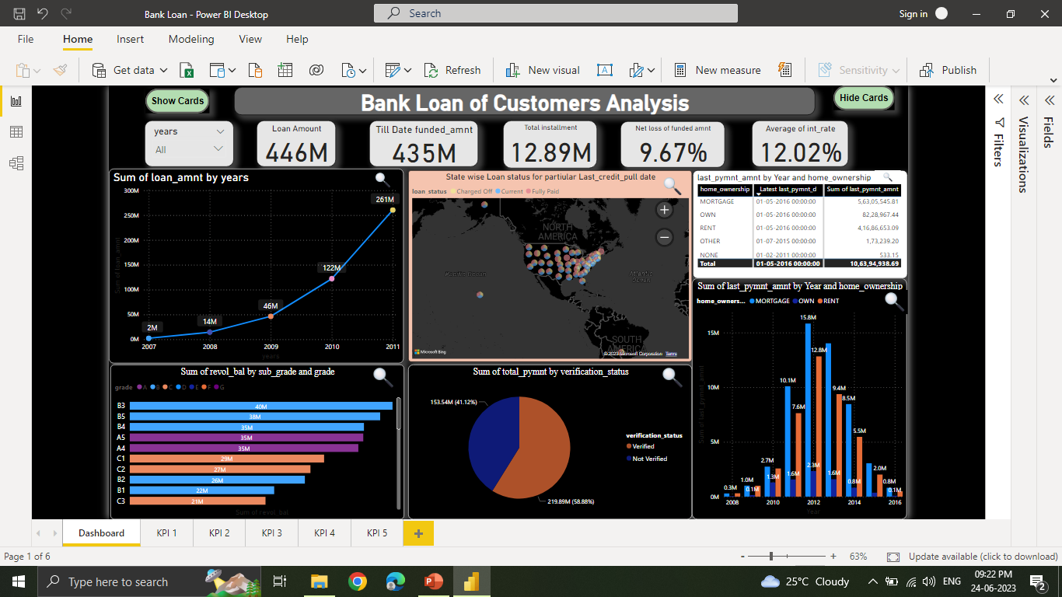
Power BI Dashboard

Slide 12
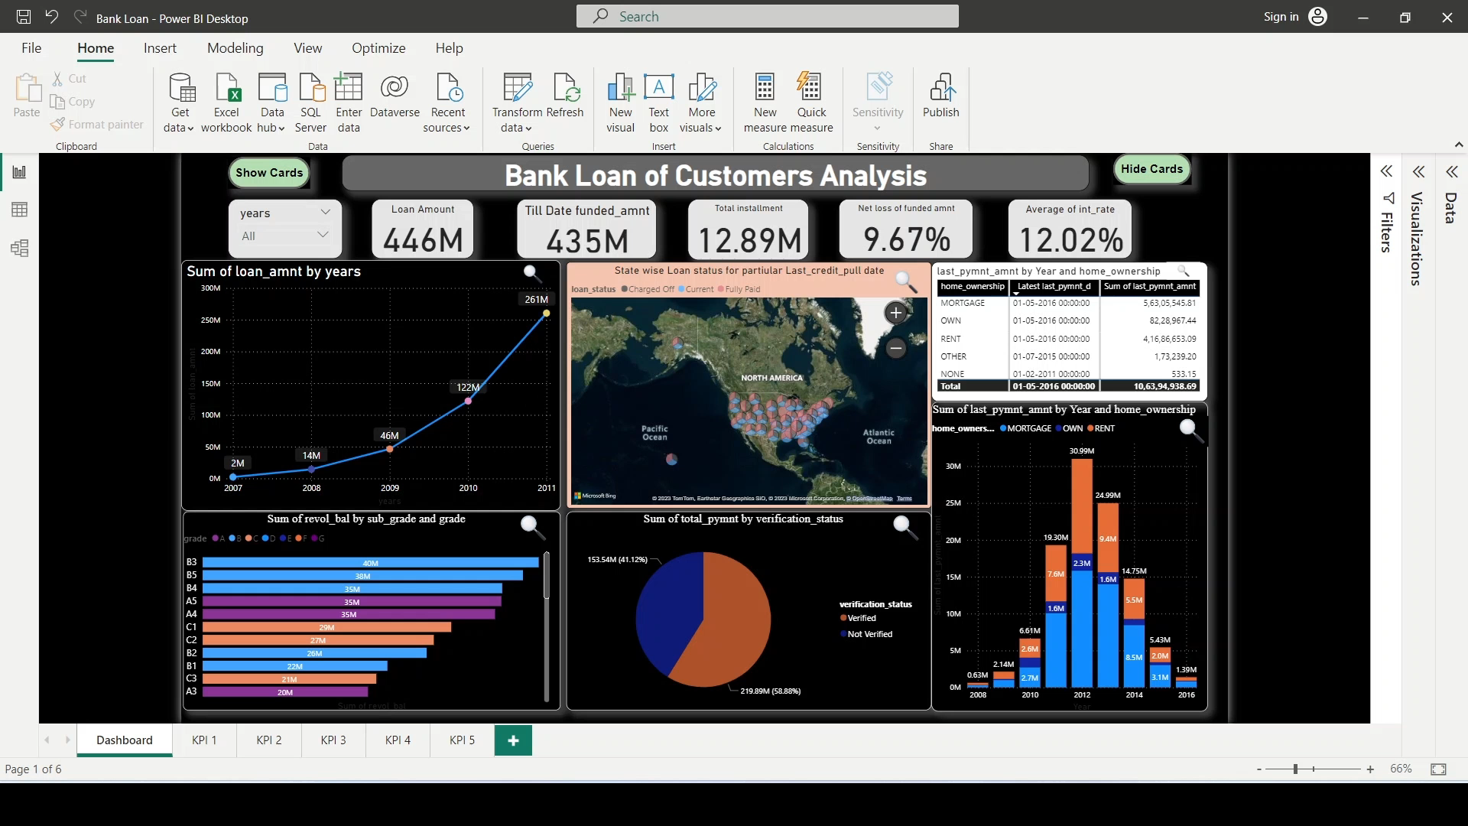
Dashboard Video

Slide 13
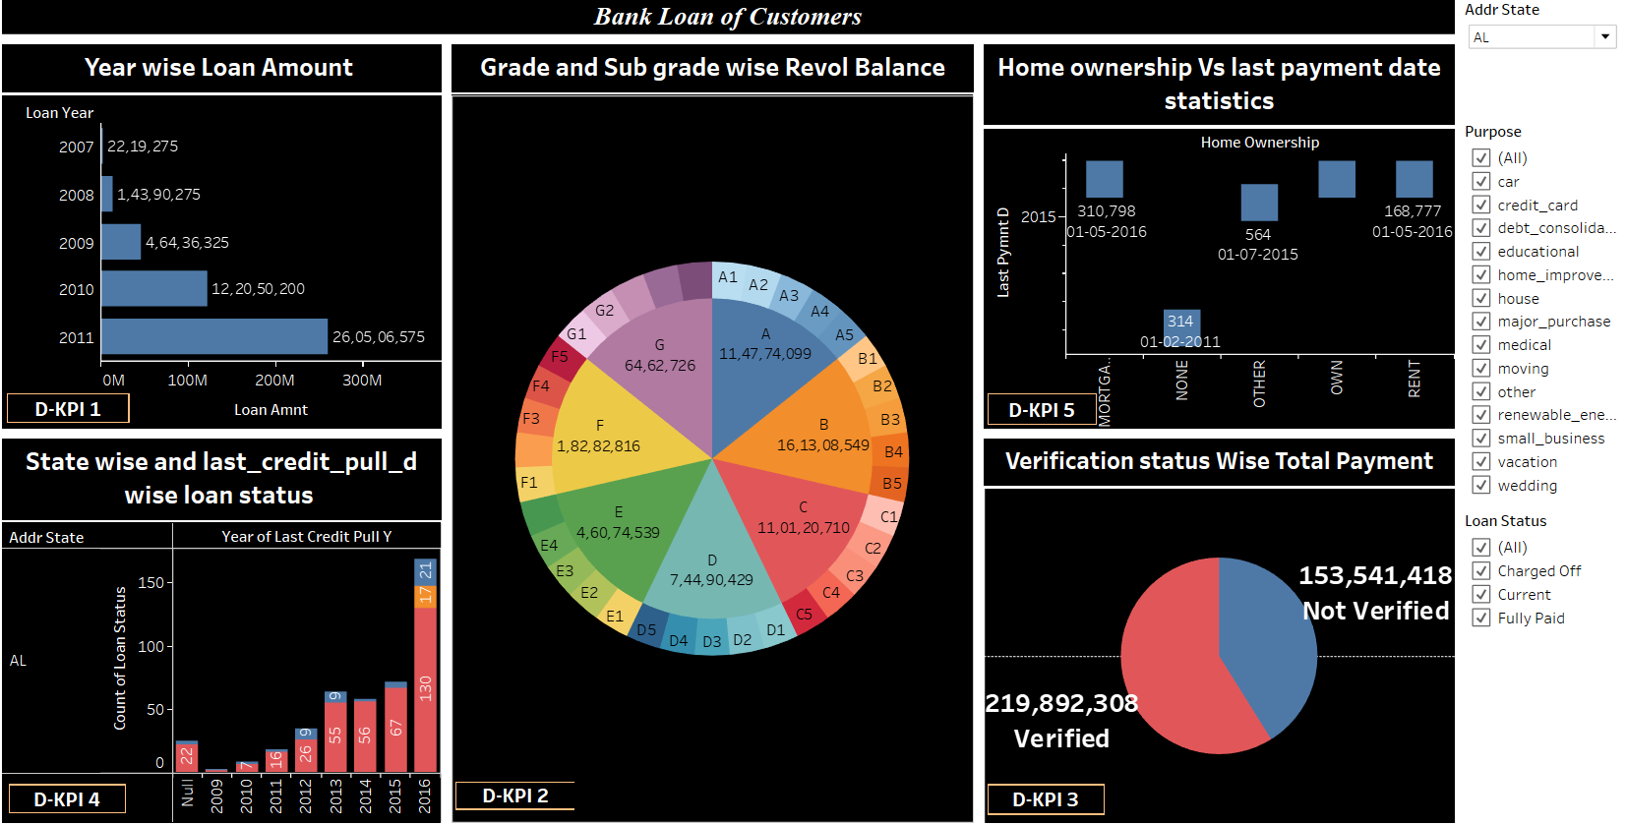
Tableau Dashboard

Slide 14
Conclusion
From the analysis of above dashboards and reports we can draw hidden insights. With the use of gained insights from the given KPI’s of finance dataset, Accurate business decisions are made and can track the business state.

Slide 15


